Slide 1

Detecting dark energy with cold atoms
粒子物理前沿问题研讨会 2019年1月20日— 1月25日
张海潮
Hai-Chao Zhang
Key Laboratory for Quantum Optics,
Shanghai Institute of Optics and Fine Mechanics, CAS,
Shanghai 201800, China
2019. 1.24
广州,中山大学南校园

Slide 2
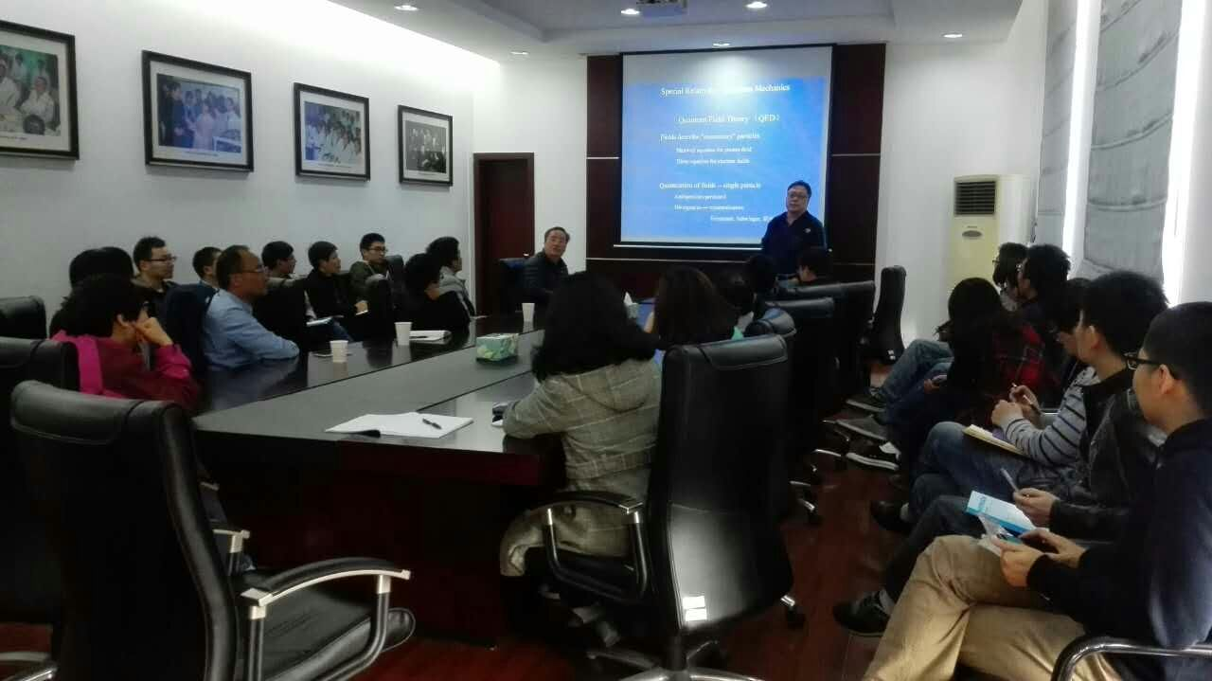
引子
Justin Khoury and Amanda Weltman; Chameleon Fields: Awaiting Surprises for Tests of Gravity in Space (Received 10 September 2003; published 22 October 2004)

Slide 3
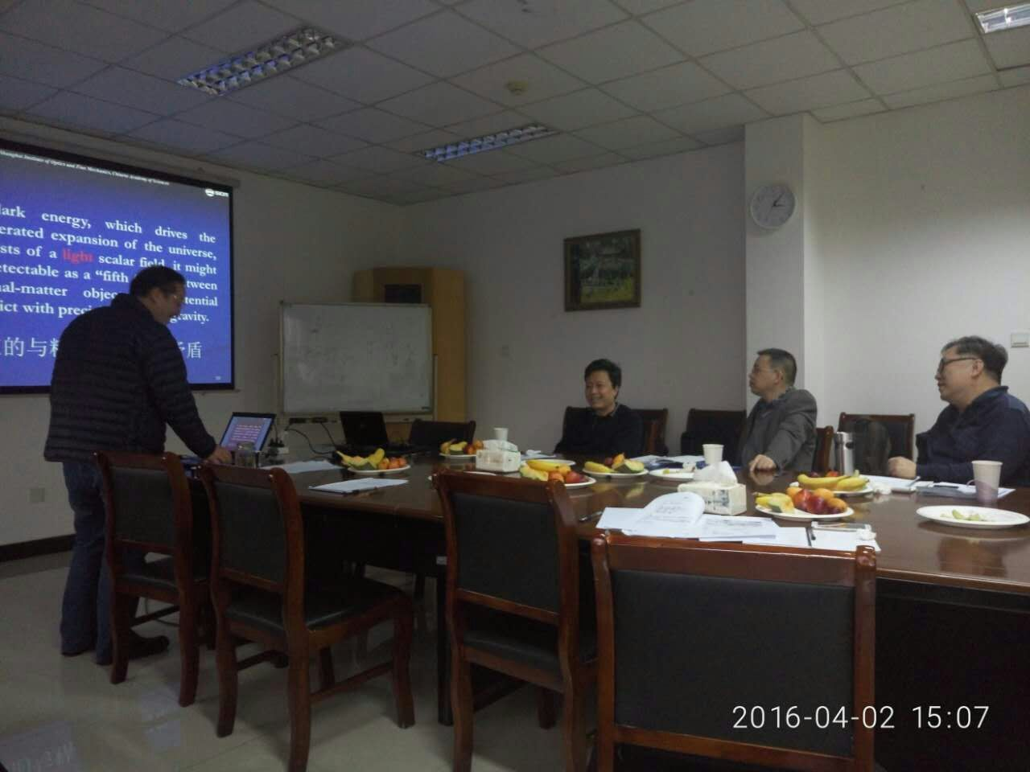

Slide 4

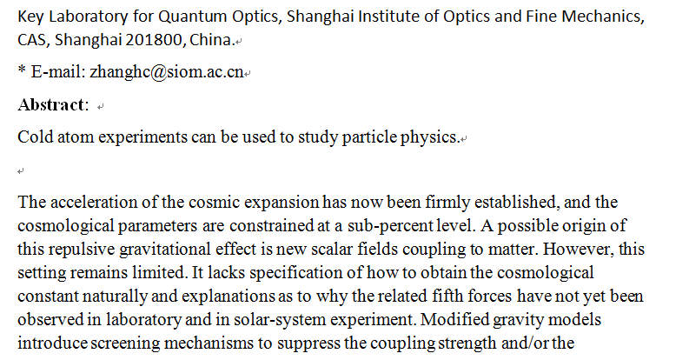

Slide 5
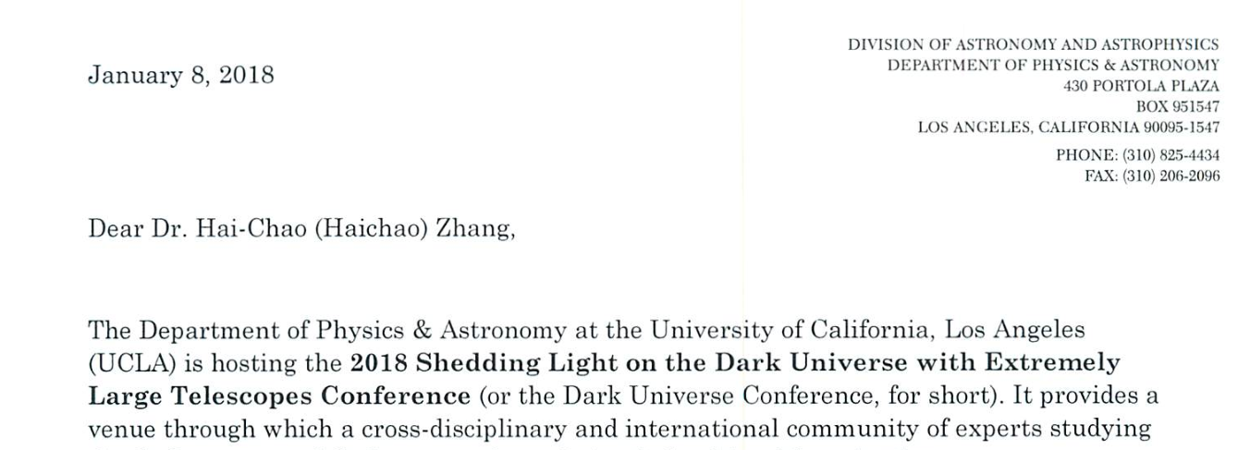
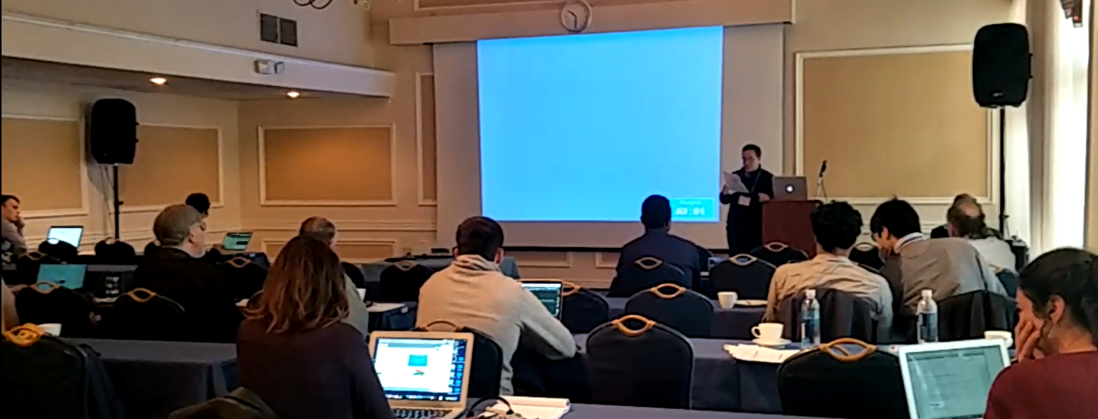

Slide 6
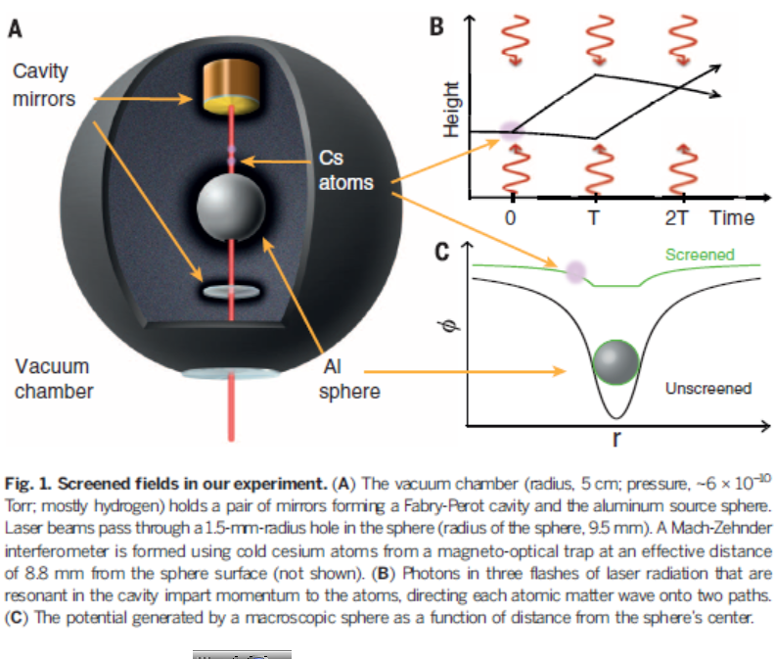
P. Hamilton, M. Jaffe, P. Haslinger, Q. Simmons, H. Mller, and J. Khoury, “Atom-interferometry constraints on dark energy,” Science 349 (2015) 849–851, arXiv:1502.03888 [physics.atom-ph].

Slide 7

Motivation
Probing Strategy and Experimental logic
Our experimental setup
Experimental results
Explanation and other alternatives
Conclusions

Slide 8
Motivation
The accelerated expansion of the universe implies the possibility of the presence of a scalar field.
This field would result in a detectable force between normal-matter objects.
But, why the associated fifth forces have not yet been detected in Laboratory and solar-system experiments so far?
The scalar field models with screening mechanism state that the force should be strong in a thin shell near the surface of a source object but greatly suppressed inside and outside of the source object.
Based on this notion, we focus our attention on how to approach the thin shell region.

Slide 9

Probe strategy and experimental designing clue:
To identify and judge where the force does exist or not in some level, for example, electroprobe or electroscope in electrics, rather than to measure precisely how much “it” is, such as coulometer.
Theory and experiment so far imply that the scalar field and the resulting fifth force could vary with the environment, and the force might strong near by the surface of an object .
d
Therefore , two objects should be needed. And they might be formed from a dilute atomic gas so that, not only the screening effect could be suppressed as much as possible, but also one of them could pass through another one and sense the thin-shell effect.

Slide 10
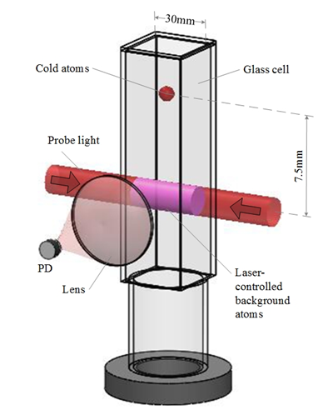
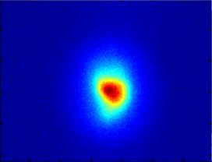
Schematic of our experimental setup
8 mm
There were two atom clouds in our experiment: a laser-cooled atom cloud and a part of background atoms stimulated by the probe laser light. The uncooled background-atom cloud acted as the source of the scaler field and the cooled cloud as the test mass to sense the scalar field; so the test mass could pass through the thin-shell region of the source mass.

Slide 11
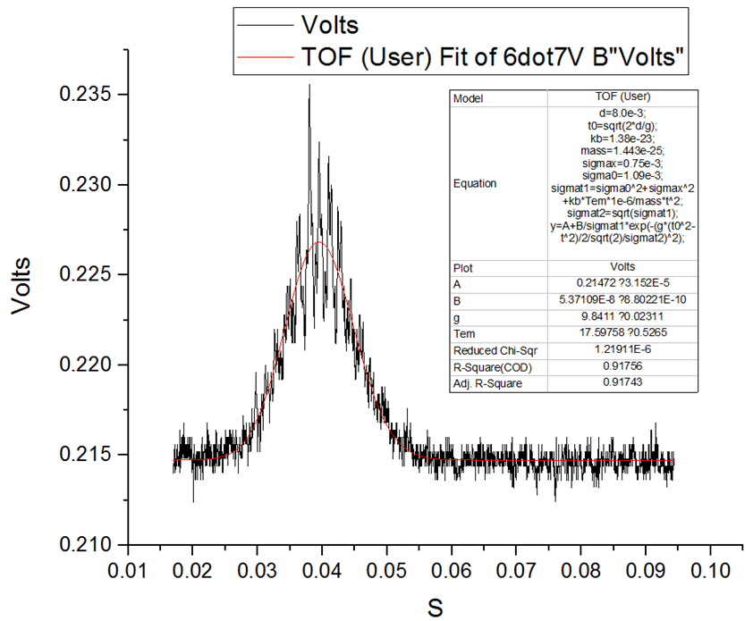
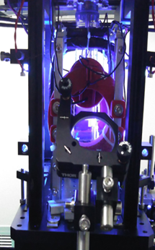
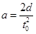
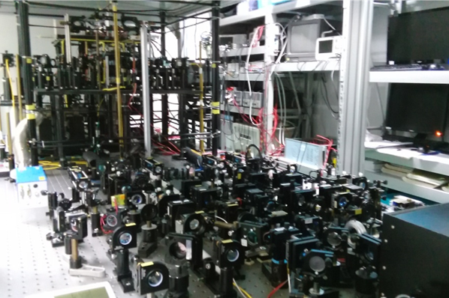
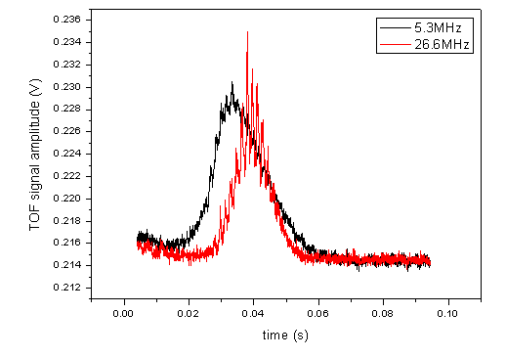
Experimental setup
We detected the fall acceleration of the test atoms by monitoring their fluorescence with a photodiode (PD)

Slide 12
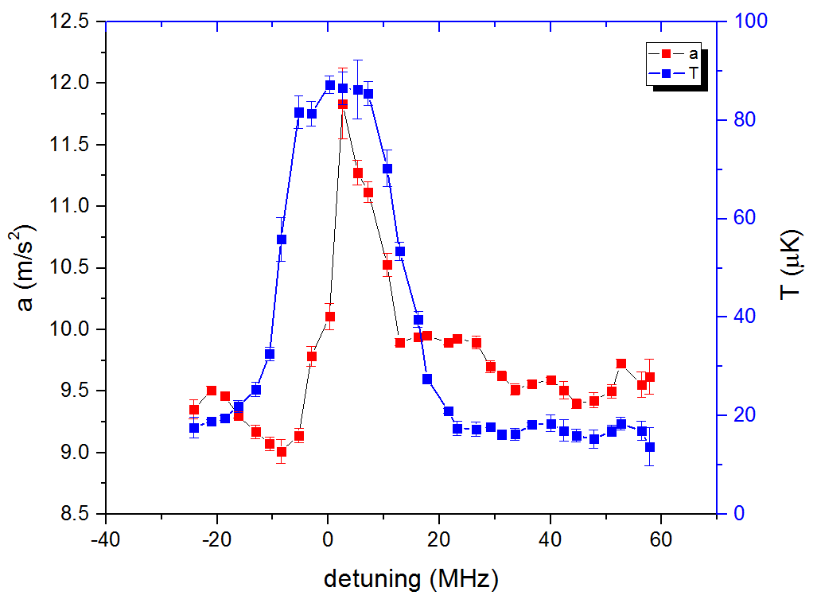
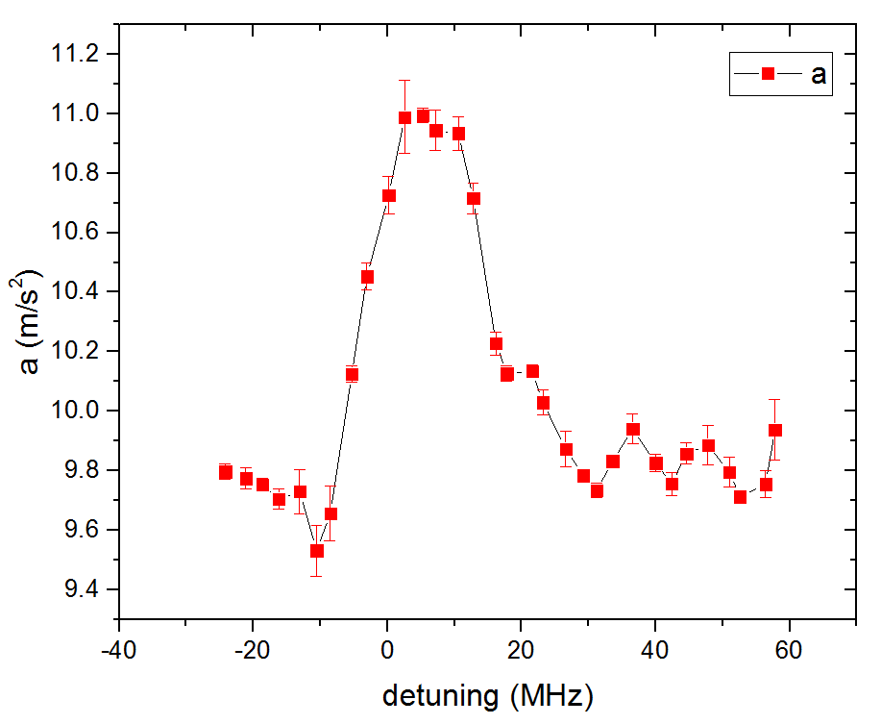
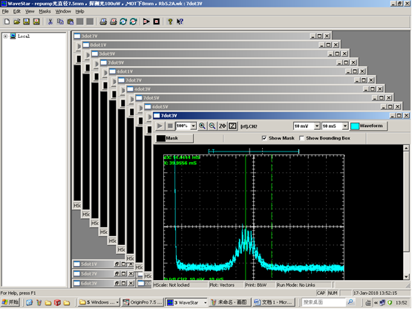
Experimental results
Varying the frequency of the probe beams while fixing their power, we obtained the detuning-dependence of the fall accelerations of the test atom clouds.
When the laser frequency was tuned near and above the atomic resonance, the measured fall acceleration increased and even exceeded the free-fall acceleration
In the red-detuning regime, the fall accelerations were lowered relatively to the free-fall acceleration (9.794 m/s^2 at Shanghai, China)

Slide 13
Explanation and other alternatives
Radiation pressure of the fluorescence of the background
The irradiation pressure to the test atoms depends on the detuning. The detuning-dependent acceleration is upward whether the detuning is negative or positive.

Slide 14
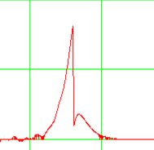
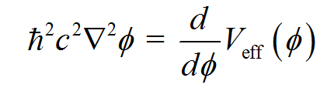
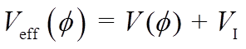
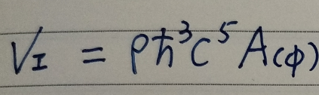
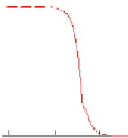
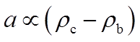
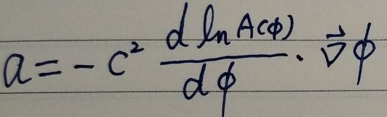

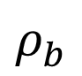

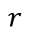
Explanation and other alternatives
The scalar equation of motion is
Fall acceleration of cold atoms would increase near the surface, when the mass density of source is larger than that of the background.
$$φ$$
$$ρ_{b}$$
$$ρ_{c}$$
A new or fifth-force pulls a test object towards the source mass with acceleration
$$r$$
Fall acceleration of the cold atoms would decrease near the surface, when the mass density of source is smaller than that of the background.
Clare Burrage,a; and Jeremy Sakstein arXiv:1709.09071v1 [astro-ph.CO] 26 Sep 2017

Slide 15
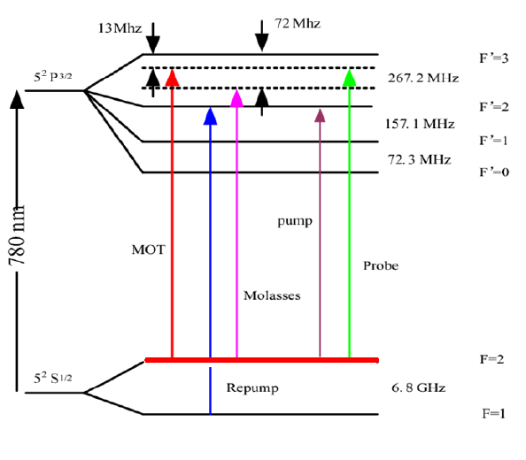
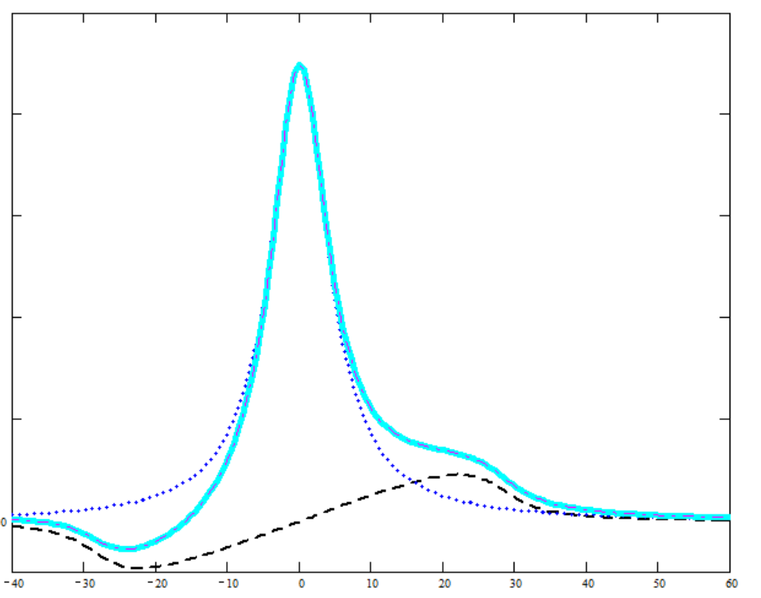
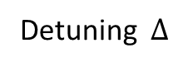
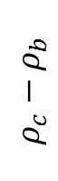
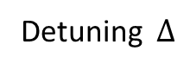
The density of the transferred energy to the source from the probe laser light versus the detuning
Detuning $∆$
$$ρ_{c}−ρ_{b}$$
Detuning $∆$
the equilibrium time
Rubidium 87 D2 transition hyperfine structure

Slide 16
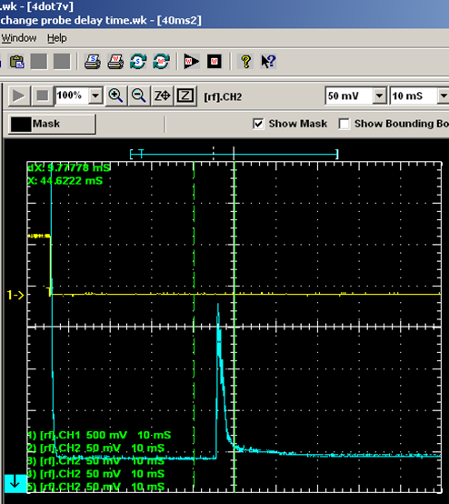
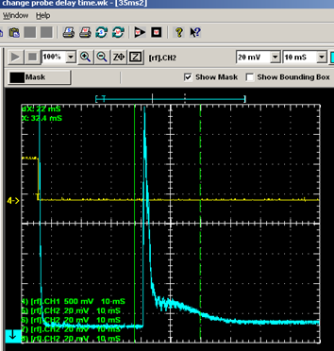

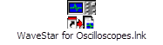
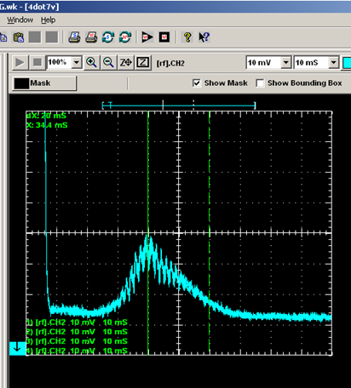
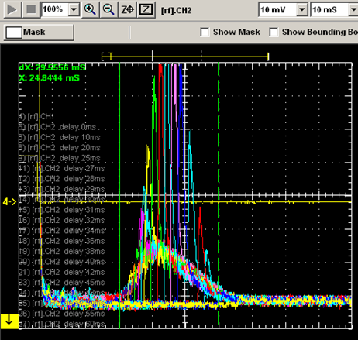
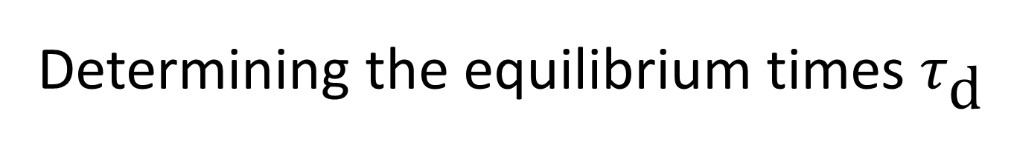
Determining the equilibrium times $τ_{\text{d}}$

Slide 17
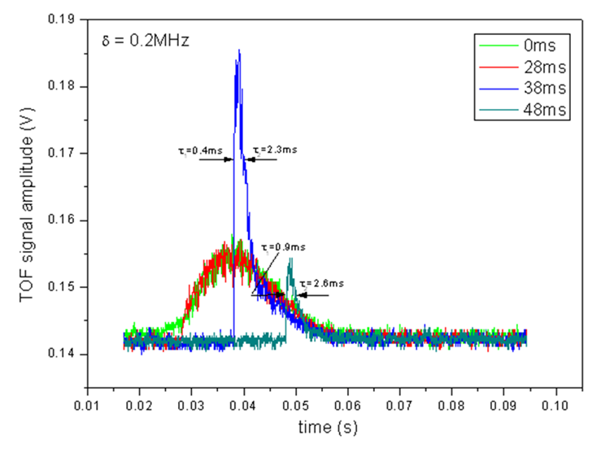
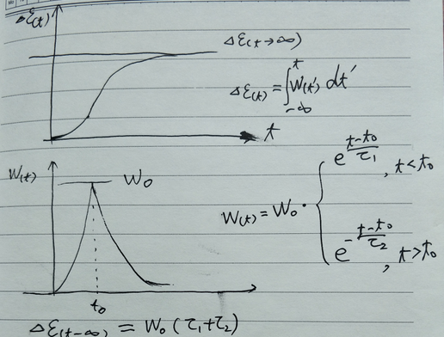
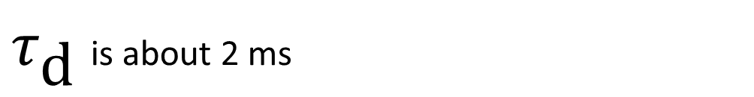
$τ_{\text{d} }$is about 2 ms

Slide 18
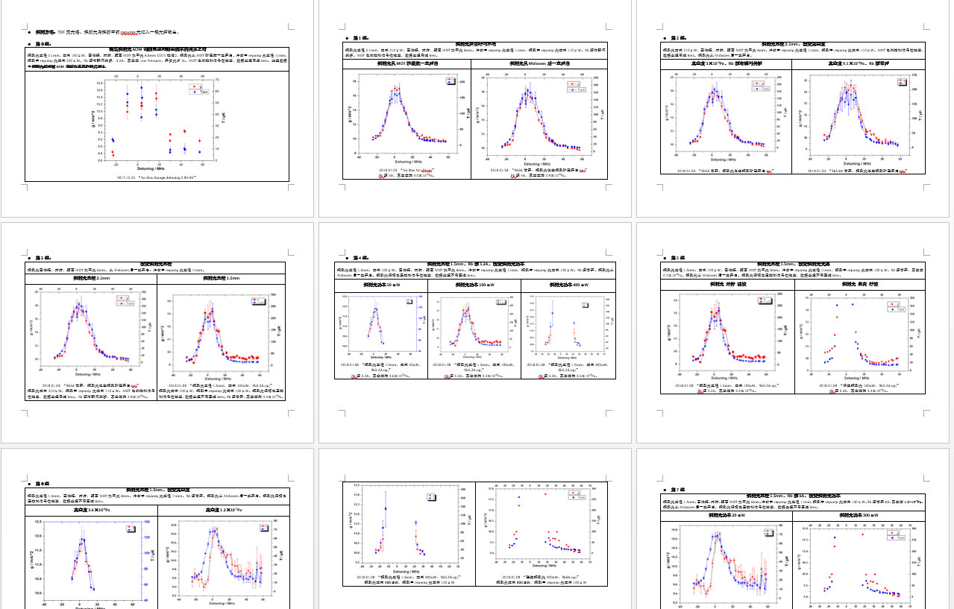
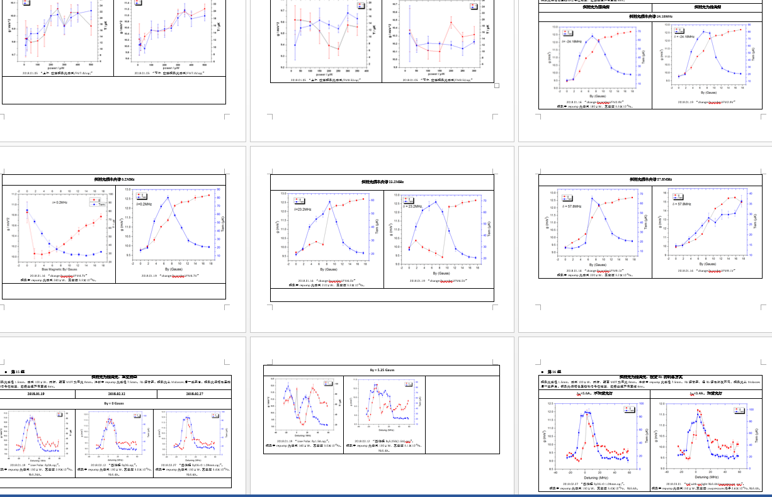
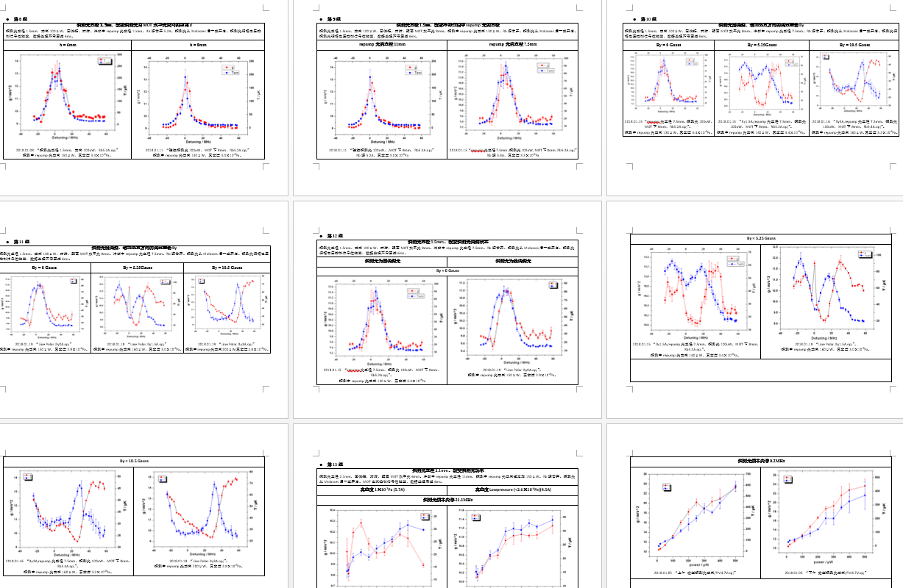
We replicated the experiment under as many conditions as we could think of.
J. Khoury and A. Weltman, “Chameleon fields: Awaiting surprises for tests of gravity in space,” Phys. Rev. Lett. 93 (2004) 171104, arXiv:astro-ph/0309300 [astro-ph].

Slide 19
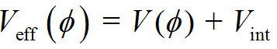
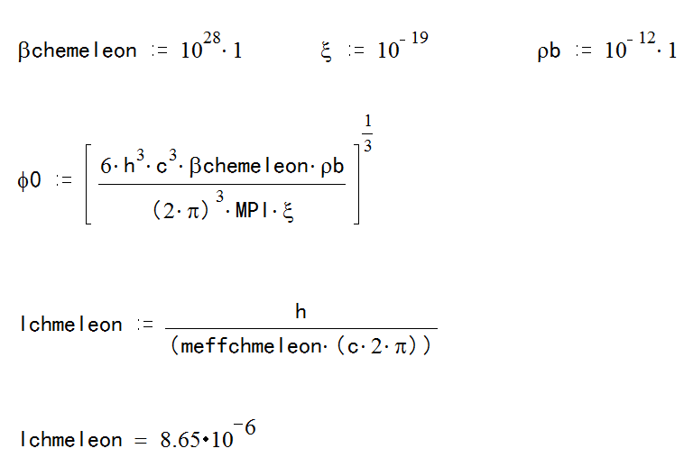
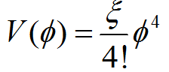
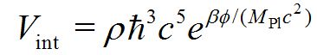
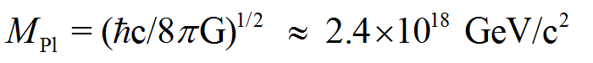
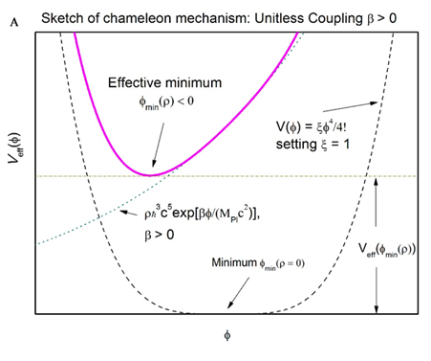
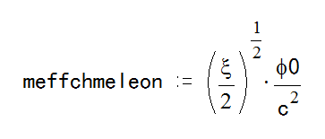
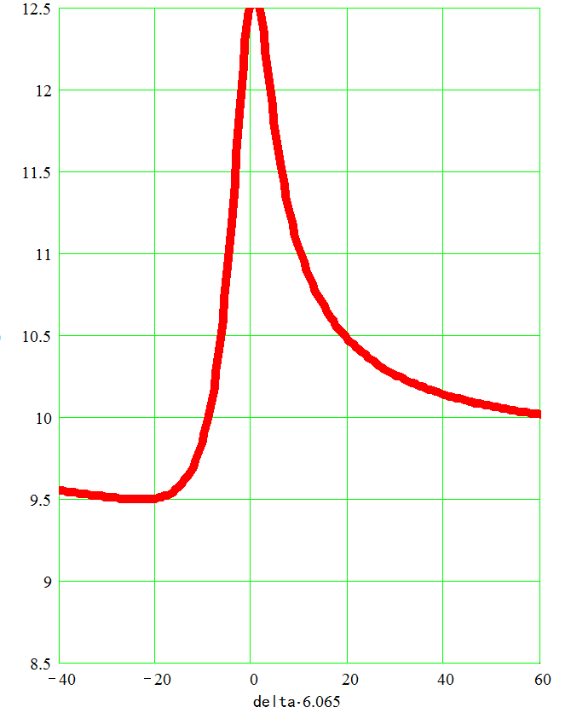




Chameleon mechanism
The coupling is too large, $≫{10}^{14}$
A upper bound, $β<{10}^{14}$, was derived from hydrogen spectroscopy.
P. Brax, C. Burrage, Phys. Rev. D Part. Fields Gravit. Cosmol. 83, 035020 (2011)

Slide 20













Symmetron mechanism
$$≫{10}^{14}$$
P. Brax, C. Burrage, Phys. Rev. D Part. Fields Gravit. Cosmol. 83, 035020 (2011)
A upper bound, $β<{10}^{14}$, was derived from hydrogen spectroscopy.

Slide 21




A. Linde, Particle Physics and Inflationary Cosmology, Harwood, Chur (1990)

Slide 22
Our new model
Consider the action governing the dynamics of a scalar field

Slide 23
Results of the model

Slide 25

Fitting the experimental data with new model

Slide 26

In our model, the coupling to matter is dependent on the density of environment, which can avoid the conflict to the upper-limit.
P. Brax, C. Burrage, Phys. Rev. D Part. Fields Gravit. Cosmol. 83, 035020 (2011).

Slide 27
Conclusions:
We demonstrated detuning-dependent slowing and quickening of a laser-cooled atomic sample in the gravitational field of the Earth. We attribute it to a fifth force.
In our design the test mass can pass through the thin-shell region of the source mass, the fifth force in the thin-shell region can be sensed.
A novel model avoids the conflict with the upper-limit derived from hydrogen spectroscopy .

Slide 28
Thank you! Questions?
you may click on the following link: https://arxiv.org/abs/1702.03050
For more information, you may reach me at zhanghc@mail.siom.ac.cn
Hai-Chao Zhang
Key Laboratory for Quantum Optics,
Shanghai Institute of Optics and Fine Mechanics, CAS,
Shanghai 201800, China

